Slide 1
Azure Data Warehouse In-A-Day
Keshav Pokkuluri
Casey Karst
Kal Yella

Slide 2
Agenda
8:45 AM to 9:00 AM Welcome
9:00 AM to 9:45 AM Datawarehouse Patterns & SQL DW Overview
9:45AM to 10:30 AM SQL DW Gen2 New Features & Functionality
Break: 10:30 AM to 10:45 AM
10:45 AM to 11:15 PM SQLDW Loading Best Practices
11:15 AM to 12:00 PM SQLDW Operational Best Practices
Lunch: 12:00 PM to 1:00 PM SQLDW Roadmap Discussion
1:00 PM to 1:45 PM SQL DW Compete Discussion
Break: 1:45 PM to 2:00 PM
2:00 PM to 2:45 PM Lab 1: Data loading scenarios and best practices
2:45 PM to 3:30 PM Lab 2: Performance Tuning best practices
3:30 PM to 4:30 PM Lab 3: Monitoring, Maintenance and Security
4:30 PM to 5:00 PM Q&A and Wrap-up
Notes:
Quickly go through Test Cases to refresh everyone and relate them to agenda topics for the day

Slide 3
Wifi – MSFTWIFI
PWD - Microsoft

Slide 4



Azure SQL DW Service
A relational data warehouse-as-a-service, fully managed by Microsoft.
Industries first elastic cloud data warehouse with proven SQL Server capabilities.
Support your smallest to your largest data storage needs.
Elastic scale & performance
Market Leading Price & Performance
Powered by the Cloud
Azure
Azure
Get started in minutes
Integrated with Azure ML, PowerBI, ADB & ADF
Scales beyond petabytes of data
Cloud DW Scale-out Processing
Instant-on compute scales in seconds
Query Relational / Non-Relational
Saas
Simple billing compute & storage
Pay for what you need, when you need it with dynamic pause
Azure
Office 365
Office 365
Public
Cloud
Notes:
Dramatic pause (hahaha)
ADW’s place in the SQL Server landscape
On-premis SQL Server
APS/PDW
IaaS SQL Server
SQL DB
SQL DB Managed Instance
Hyper Scale Options
Elastic Database Options
Azure Data Warehouse

Slide 5
cloud Data Warehouse
INGEST
STORE
PREP & TRAIN
MODEL & SERVE
Files (unstructured)
PolyBase
Azure Data Factory
Azure Blob Storage
Azure SQL Data Warehouse
Azure Analysis Services
Power BI
Business/custom apps
(structured)
Microsoft Azure also supports other Big Data services like Azure HDInsight and Azure Data Lake to allow customers to tailor the above architecture to meet their unique needs.

Slide 6


Modern Data Warehouse
INGEST
STORE
PREP & TRAIN
MODEL & SERVE
Logs (unstructured)
Azure Databricks
Media (unstructured)
PolyBase
Files (unstructured)
Azure Data Factory
Azure Blob Storage
Azure SQL Data Warehouse
Azure Analysis Services
Power BI
Business/custom apps
(structured)
Microsoft Azure also supports other Big Data services like Azure HDInsight and Azure Data Lake to allow customers to tailor the above architecture to meet their unique needs.

Slide 7
hub & Spoke architecture for bi
INGEST
STORE
PREP & TRAIN
MODEL & SERVE
Data Marts
Business/custom apps
(structured)
SQL
Azure Databricks
Multiple Azure SQL Database instances
Logs (unstructured)
PolyBase
Azure Data Factory
Azure Blob Storage
Azure SQL Data Warehouse
Power BI
Media (unstructured)
Data Cubes
Multiple Azure Analysis Services instances
Files (unstructured)
Microsoft Azure supports other services like Azure HDInsight and Azure Data Lake in various layers to allow customers a truly customized solution.

Slide 8

Real time analytics
INGEST
STORE
PREP & TRAIN
MODEL & SERVE
Sensors and IoT
(unstructured)
Azure Databricks
Logs (unstructured)
Apache Kafka for HDInsight
Media (unstructured)
Files (unstructured)
PolyBase
Business/custom apps
(structured)
Azure Data Factory
Azure Blob Storage
Azure SQL Data Warehouse
Azure Analysis Services
Power BI
Microsoft Azure also supports other Big Data services like Azure IoT Hub, Azure Event Hubs, Azure Machine Learning and Azure Data Lake to allow customers to tailor the above architecture to meet their unique needs.
Notes:
Microsoft Azure supports other services like Azure HDInsight, Azure Data Lake, Azure IoT Hub, Azure Events Hub in various layers of the architecture above to allow customers a truly customized solution.

Slide 9
Azure SQL DW Overview
Azure SQL DW CSE

Slide 10
Under the hood - Architecture

Slide 11
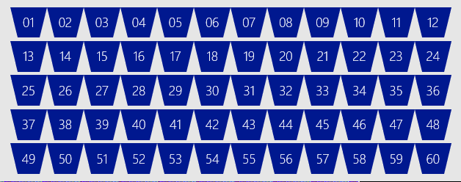
SQL DW Fundamentals
Control
Control
Connection and tool endpoint. Coordinates compute activity.
Engine
DMS
SQL DB
Compute
Handles query processing, ability to scale up/down
Compute
Compute
Compute
Compute
DMS
DMS
DMS
DMS
SQL DB
SQL DB
SQL DB
SQL DB
Dist_DB_1
Dist_DB_2
Dist_DB_15
Dist_DB_16
Dist_DB_17
Dist_DB_30
Dist_DB_31
Dist_DB_32
Dist_DB_45
Dist_DB_46
Dist_DB_47
Dist_DB_60
DMS: Data Movement Services
Coordinates data movement between nodes
…
…
…
…
Storage
Remote storage. Scales independently of compute
Blob Storage
Notes:
Compute Node VM hosting two key components of SQL DW.
These two key SQL DB and DMS.
DMS, stands for Data Movement Service
cover more later on why move data
SQL DB crunching the data and DMS moving
Third component to SQL DW, the Engine.
primary function is to optimize and manage incoming work.
Engine parses and creates query plans.
Compute node has several SQL databases.
MPP
Data is distributed into 60 distributions on storage
Each compute node is associated with a set of distributions
1 Node would have all 60 distributions
60 nodes would have 1 distribution each
This example is DW500, each compute node is hosting 12 databases.
Let’s say we want to take this DW500 and scale it up to a DW1000
What happens behind the scenes?
(1) take all of the SQL Databases down, (2) add 5 more compute nodes
(3) start up the SQL DB databases again.
some of the databases are on different compute nodes
6 distributions per node rather than 12
Each Node has half the work now

Slide 12
Data Warehouse Units
DWUc | Nodes | Dist/Node
100 | 1 | 60
200 | 1 | 60
300 | 1 | 60
400 | 1 | 60
500 | 1 | 60
1000 | 2 | 30
1500 | 3 | 20
2000 | 4 | 15
2500 | 5 | 12
3000 | 6 | 10
5000 | 10 | 6
…
30000 | 60 | 1
Normalized amount of compute
Converts to billing units i.e. what you pay
CPU
RAM
I/O
Notes:
Need to modify for Gen2

Slide 13


Separate compute from storage
SQL
Control
Compute
Premium Storage
Notes:
De-coupled storage from compute & control
Completely elastic
Pay for the data you store and the compute you provision

Slide 14
Independently scale compute
SQL
Control
Compute
Premium Storage
Notes:
De-coupled storage from compute & control
Completely elastic
Pay for the data you store and the compute you provision

Slide 15
Pause and resume workload
SQL
Control
Compute
Premium Storage
Notes:
De-coupled storage from compute & control
Completely elastic
Pay for the data you store and the compute you provision

Slide 16
Query Execution
Result
Query
SQL
Control
Compute
Premium Storage

Slide 17
Concurrent queries
QID
QID
128
active queries
1024
open sessions
QID
QID
QID
QID
Notes:
https://docs.microsoft.com/en-us/azure/sql-data-warehouse/sql-data-warehouse-concept-recommendations

Slide 18
Concurrency slots
Concurrency Slots
20 per DW500c: 250MB/slot
4 per DW100c: 100MB/slot
Total system
available memory

Slide 19
Concurrent Query and Slots
Notes:
Query cap = number of running queries
Slots = size of queries that are running
Concurrency slots are NOT changing with the increase to concurrency.

Slide 20
Resource classes
Dynamic
Increases resource consumption as you scale
No increase in concurrency as you scale
Static
Maintain resource consumption as you scale
Increase concurrent queries as you scale
Consume Slots
Increase memory
Isolate resources
Notes:
Key point:
-Dynamic: as you scale, queries have more slots and ram to run faster, not more of those queries.
-Static: as you scale, queries have the same amount of slots and ram, you can run more of them.

Slide 21

Resource Classes – Dynamic
Allocates variable amounts of memory depending on the scale of the DW instance.
Beneficial for variable sized workloads that scale to meet demand.
There is no increase in concurrency with scaling.
Scaling up

Slide 22
Dynamic Resource Classes
With Gen2, dynamic resource pools were introduced with a 3-10-22-70 model for resource allocations.
Resource Class | Percent Resources
SmallRc | 3%
MediumRc | 10%
LargeRc | 22%
XLargeRc | 70%
Resource Class | Percent Resources | Concurrency
SmallRc | 3% | 32
MediumRc | 10% | 10
LargeRc | 22% | 4
XLargeRc | 70% | 1

Slide 23
Resource Classes – Static
Allocates a fixed amount of memory regardless of the scale level.
Essential for high query concurrency workloads.
Queries may run the same regardless of the service level.
Scaling up

Slide 24
Gen 2 Concurrency – Static RC
Service Level | Maximum concurrent queries | Concurrency slots available | staticrc10 | staticrc20 | staticrc30 | staticrc40 | staticrc50 | staticrc60 | staticrc70 | staticrc80
DW100c | 4 | 4 | 1 | 2 | 4 | 4 | 4 | 4 | 4 | 4
DW200c | 8 | 8 | 1 | 2 | 4 | 8 | 8 | 8 | 8 | 8
DW300c | 12 | 12 | 1 | 2 | 4 | 8 | 8 | 8 | 8 | 8
DW400c | 16 | 16 | 1 | 2 | 4 | 8 | 16 | 16 | 16 | 16
DW500c | 20 | 20 | 1 | 2 | 4 | 8 | 16 | 16 | 16 | 16
DW1000c | 32 | 40 | 1 | 2 | 4 | 8 | 16 | 32 | 32 | 32
DW1500c | 32 | 60 | 1 | 2 | 4 | 8 | 16 | 32 | 32 | 32
DW2000c | 48 | 80 | 1 | 2 | 4 | 8 | 16 | 32 | 64 | 64
DW2500c | 48 | 100 | 1 | 2 | 4 | 8 | 16 | 32 | 64 | 64
DW3000c | 64 | 120 | 1 | 2 | 4 | 8 | 16 | 32 | 64 | 64
DW5000c | 64 | 200 | 1 | 2 | 4 | 8 | 16 | 32 | 64 | 128
DW6000c | 128 | 240 | 1 | 2 | 4 | 8 | 16 | 32 | 64 | 128
DW7500c | 128 | 300 | 1 | 2 | 4 | 8 | 16 | 32 | 64 | 128
DW10000c | 128 | 400 | 1 | 2 | 4 | 8 | 16 | 32 | 64 | 128
DW15000c | 128 | 600 | 1 | 2 | 4 | 8 | 16 | 32 | 64 | 128
DW30000c | 128 | 1200 | 1 | 2 | 4 | 8 | 16 | 32 | 64 | 128

Slide 25
Data Distribution

Slide 26
Table Distribution Options
Hash Distributed
Round Robin
(Default)
Replicated
Data divided across nodes based on hashing algorithm
Same value will always hash to same distribution
Single column only
Data distributed evenly across nodes
Easy place to start, don’t need to know anything about the data
Simplicity at a cost
Data repeated on every node
Simplifies many query plans and reduces data movement
Best with joining hash table
Check for Data Skew, NULLS, -1
Will incur more data movement at query time
Consumes more space
Joining two Replicated Table runs
on one node

Slide 27
Creating tables
CREATE TABLE [build].[FactOnlineSales]
(
[OnlineSalesKey] int NOT NULL
, [DateKey] datetime NOT NULL
, [StoreKey] int NOT NULL
, [ProductKey] int NOT NULL
, [PromotionKey] int NOT NULL
, [CurrencyKey] int NOT NULL
, [CustomerKey] int NOT NULL
, [SalesOrderNumber] nvarchar(20) NOT NULL
, [SalesOrderLineNumber] int NULL
, [SalesQuantity] int NOT NULL
, [SalesAmount] money NOT NULL
)
WITH
( CLUSTERED COLUMNSTORE INDEX
, DISTRIBUTION = ROUND_ROBIN
)
;
CREATE TABLE [build].[FactOnlineSales]
(
[OnlineSalesKey] int NOT NULL
, [DateKey] datetime NOT NULL
, [StoreKey] int NOT NULL
, [ProductKey] int NOT NULL
, [PromotionKey] int NOT NULL
, [CurrencyKey] int NOT NULL
, [CustomerKey] int NOT NULL
, [SalesOrderNumber] nvarchar(20) NOT NULL
, [SalesOrderLineNumber] int NULL
, [SalesQuantity] int NOT NULL
, [SalesAmount] money NOT NULL
)
WITH
( CLUSTERED COLUMNSTORE INDEX
, DISTRIBUTION = HASH([ProductKey])
)
;

Slide 28
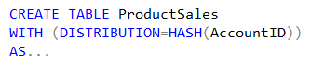
Hash Distributed
Dist_1
ProductSales – Raw Data
Dist_2
AccountID | SalesAmt | …
47 | $1,234.36 | …
36 | $2,345.47 | …
14 | $3,456.58 | …
25 | $4,567.69 | …
48 | $5,678.70 | …
37 | $6,789.81 | …
… | … | …
47 | $1,234.36 | …
Dist_3
36 | $2,345.47 | …
Hash(47)
Hash(36)
14 | $3,456.58 | …
Dist_4
25 | $4,567.69 | …
48 | $5,678.70 | …
37 | $6,789.81 | …
Dist_5
…
Dist_N

Slide 29
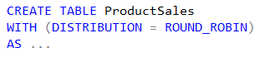
Round Robin Distributed
Dist_1
ProductSales – Raw Data
Dist_2
AccountID | SalesAmt | …
47 | $1,234.36 | …
36 | $2,345.47 | …
14 | $3,456.58 | …
25 | $4,567.69 | …
48 | $5,678.70 | …
37 | $6,789.81 | …
42 | $1,632.25 | …
88 | $4,453.21 | …
52 | $7,892.81 | ...
91 | $9,549.64 | …
66 | $2,498.14 | …
23 | $3,145.99 | …
47 | $1,234.36 | …
Dist_3
36 | $2,345.47 | …
14 | $3,456.58 | …
Dist_4
25 | $4,567.69 | …
48 | $5,678.70 | …
37 | $6,789.81 | …
Dist_5
42 | $1,632.25 | …
…
42 | $4,453.21 | …
Dist_N
52 | $7,892.81 | …
91 | $9,549.64 | …
66 | $2,498.14 | …
23 | $3,145.99 | …
Notes:
Default

Slide 30
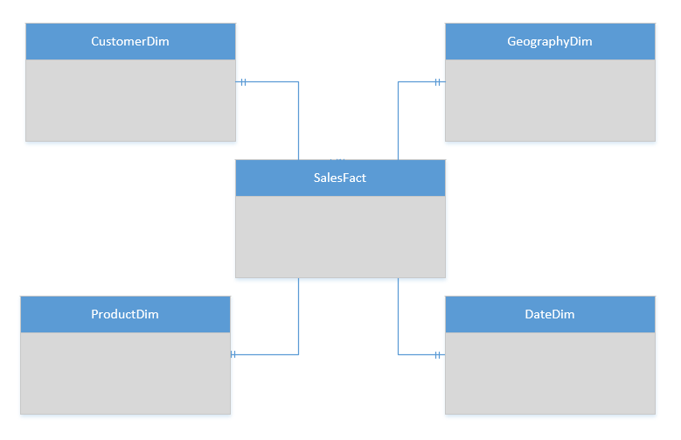
Replicated Table Scenarios
Scenarios to consider using Replicated tables:
Star schema reporting
Dimensions – descriptive entities about fact data
ETL master data, common domain data used during transaction loading

Slide 31
T-SQL: Create a Replicated table
CREATE TABLE dbo.DimCustomer
( CustomerKey int NOT NULL
, GeographyKey int NULL
, CustomerAlternateKey nvarchar(15) NOT NULL
, Title nvarchar(8) NULL
, FirstName nvarchar(50) NULL
, LastName nvarchar(50) NULL
, BirthDate date NULL
, Gender nvarchar(1) NULL
, EmailAddress nvarchar(50) NULL
, YearlyIncome money NULL
, DateFirstPurchase date NULL
)
WITH
( CLUSTERED COLUMNSTORE INDEX
, DISTRIBUTION = REPLICATED
)

Slide 32

Replicated Tables… How it works
Compute Node 1
RR Table
RR Table
RR Table
RR Table
Cache Build Request
Replication Cache Manager
Repl Table
Distribution_1
Distribution_2
Distribution_3
Distribution_4
Compute Node 2
CREATE
CREATE
SELECT
SELECT
UPDATE
UPDATE
RR Table
RR Table
RR Table
RR Table
Repl Table
Distribution_5
Distribution_6
Distribution_7
Distribution_8
Notes:
WHY A CACHE? – TO ACHIEVE ELASTICITY
With GA, the replicated table cache is no longer built as a step in the query plan during the runtime of the query. A select against a replicated table without a cache built submits a request to build the cache to the replication cache manager, asynchronously and is resolved immediately against the round robin table. The cache manager has a simple queueing mechanism and immediately builds the cache.

Slide 33
Indexing

Slide 34
Indexing Choices
Row Store : Clustered Index
Column Store : Clustered Columnstore Index
Heap : No index
Non-Clustered Index
Notes:
https://docs.microsoft.com/en-us/azure/sql-data-warehouse/sql-data-warehouse-tables-index
CCI = default
HEAP is a keyword

Slide 35
Indexing tables
CREATE TABLE [dbo].[DimStore]
(
[StoreKey] int NOT NULL
, [GeographyKey] int NOT NULL
, [StoreName] nvarchar(100) NOT NULL
, [StoreType] nvarchar(15) NULL
, [StoreDescription] nvarchar(300) NOT NULL
, [Status] nvarchar(20) NOT NULL
, [OpenDate] datetime NOT NULL
, [CloseDate] datetime NULL
, [ETLLoadID] int NULL
, [LoadDate] datetime NULL
, [UpdateDate] datetime NULL
)
WITH
( CLUSTERED INDEX([StoreKey])
, DISTRIBUTION = ROUND_ROBIN
)
;
CREATE TABLE [dbo].[FactOnlineSales]
(
[OnlineSalesKey] int NOT NULL
, [DateKey] datetime NOT NULL
, [StoreKey] int NOT NULL
, [ProductKey] int NOT NULL
, [PromotionKey] int NOT NULL
, [CurrencyKey] int NOT NULL
, [CustomerKey] int NOT NULL
, [SalesOrderNumber] nvarchar(20) NOT NULL
, [SalesOrderLineNumber] int NULL
, [SalesQuantity] int NOT NULL
, [SalesAmount] money NOT NULL
)
WITH
( CLUSTERED COLUMNSTORE INDEX
, DISTRIBUTION = HASH([ProductKey])
)
;
Row
Column
Distribution
Notes:
When to use a
Clustered Index – smaller tables like dimensions when joins are done to single rows by key
CCI – those big tables
HEAP – when tables are small and for staging tables

Slide 36
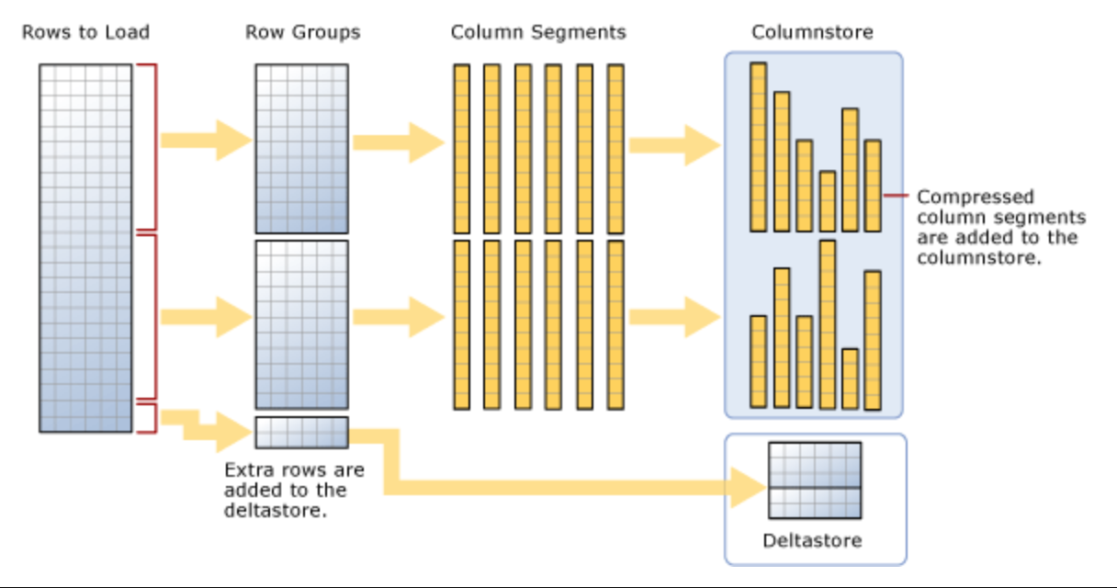
Clustered Columnstore Index
Notes:
https://docs.microsoft.com/en-us/sql/relational-databases/indexes/columnstore-indexes-described?view=sql-server-2014
A rowgroup usually contains the maximum number of rows per rowgroup which is 1,048,576 rows.
Each rowgroup contains one column segment for every column in the table.
Each column segment is compressed together and stored on physical media.

Slide 37
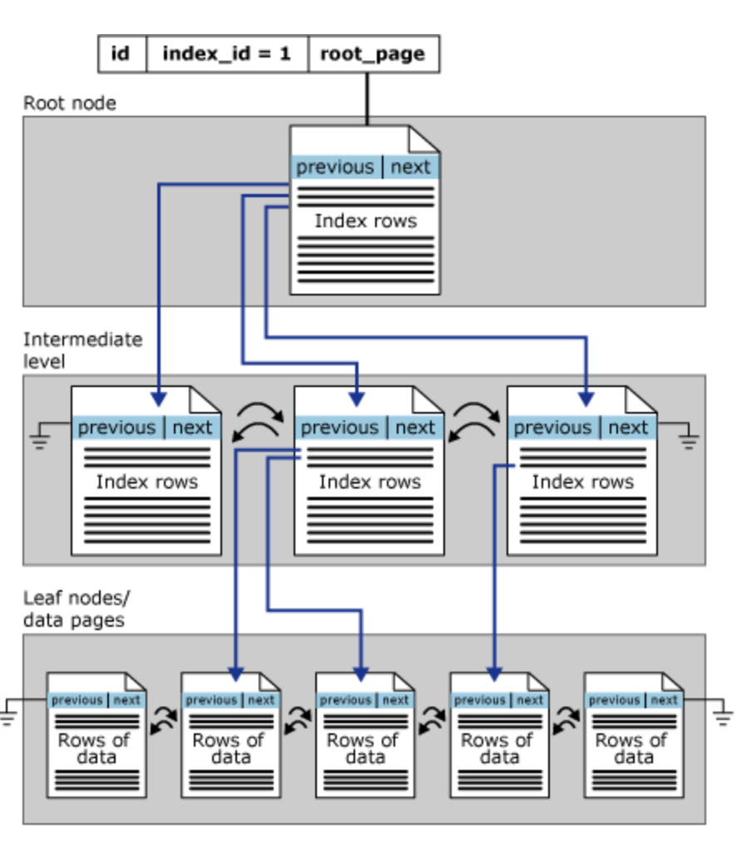
Clustered Index (Row Store)
Notes:
Clustered Index on a single partition
https://docs.microsoft.com/en-us/sql/relational-databases/sql-server-index-design-guide?view=sql-server-2017

Slide 38
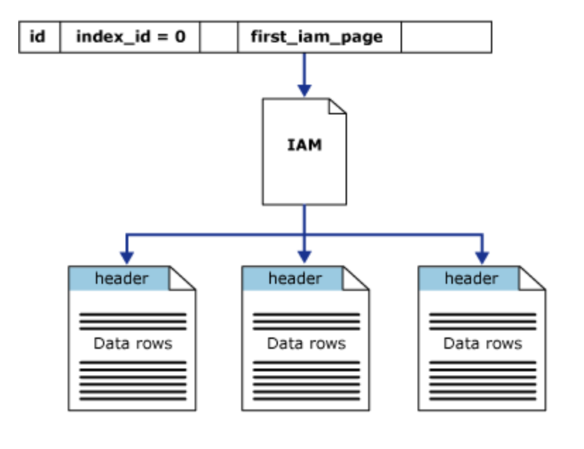
Heap (No Index)
Notes:
Heap on a single partition

Slide 39
Scale out = Distributed tables
ROW STORE
COLUMN STORE
Notes:
Illustrates the compression that you get with CCI

Slide 40
Clustered Columnstore & Partitioning
CREATE TABLE [dbo].[FactInternetSales]
(
[ProductKey] int NOT NULL ,
[OrderDateKey] int NOT NULL ,
[CustomerKey] int NOT NULL ,
[PromotionKey] int NOT NULL ,
[SalesOrderNumber] nvarchar(20) NOT NULL ,
[OrderQuantity] smallint NOT NULL ,
[UnitPrice] money NOT NULL ,
[SalesAmount] money NOT NULL
)
WITH ( CLUSTERED COLUMNSTORE INDEX ,
DISTRIBUTION = HASH([ProductKey]) ,
PARTITION ( [OrderDateKey] RANGE RIGHT FOR
VALUES (20000101,20010101,20020101,20030101,20040101,20050101)
)
)
;
Notes:
https://docs.microsoft.com/en-us/azure/sql-data-warehouse/sql-data-warehouse-tables-partition
Loading benefits
Query benefits
Careful do not over partition
need 1000000 rows per CCI segment
each distribution is partitioned (60)
For optimal compression and performance of clustered columnstore tables, a minimum of 1 million rows per distribution and partition is needed. Before partitions are created, SQL Data Warehouse already divides each table into 60 distributed databases. Any partitioning added to a table is in addition to the distributions created behind the scenes.

Slide 41
Polybase

Slide 42
Polybase parallel load from Azure Storage
Compute Node
Azure Storage Blob (ASB)
DMS
Bridge
Control Node
Compute Node
DMS
DMS
Bridge
Compute Node
DMS
Bridge

Slide 43
Additional Resources
Azure site: http://aka.ms/sqldw
SQL DW suggestions: http://aka.ms/sql-dw-feedback
Stack Overflow – Tag: azure-sqldw
Twitter: @AzureSQLDW
Nominate: http://aka.ms/engage_dw_cse

Slide 44
Q&A

Slide 45
Data Protection

